Slide 1
Design circuit with neural network

Slide 2
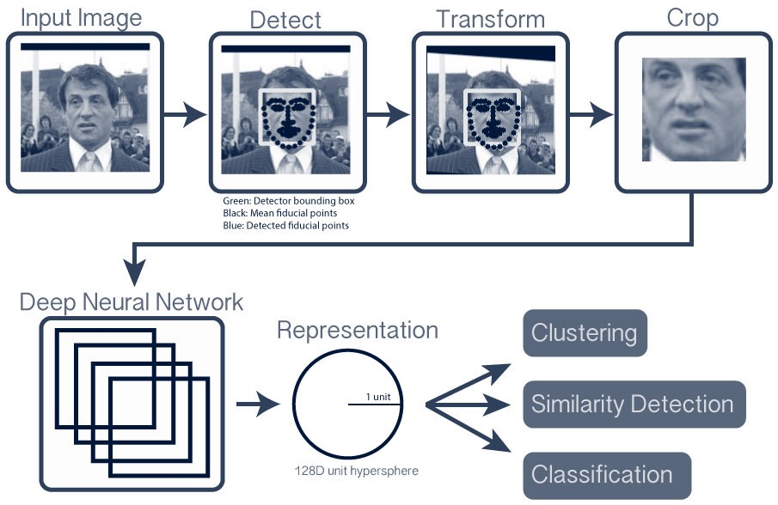
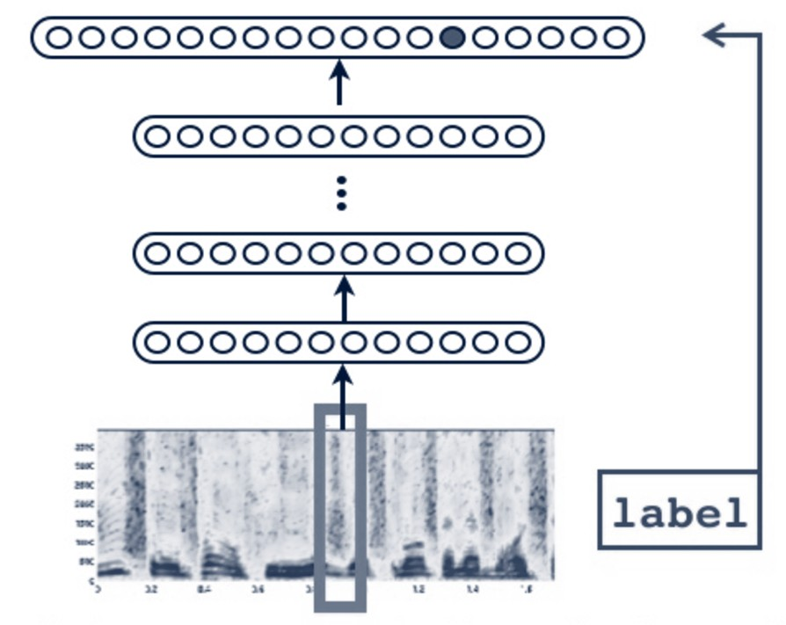
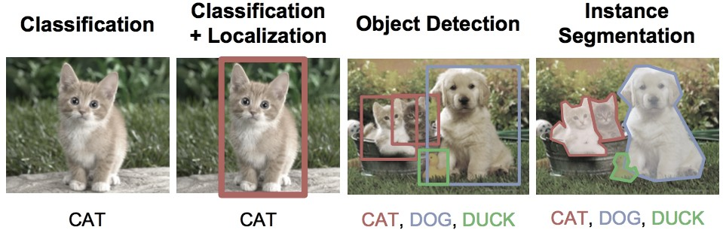
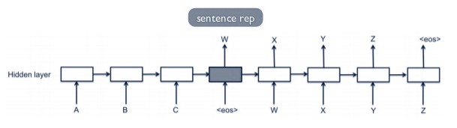
Applications of AI
Object Recognition: Facial
Object Recognition: Speech
Object Classification
Language Translation

Slide 3
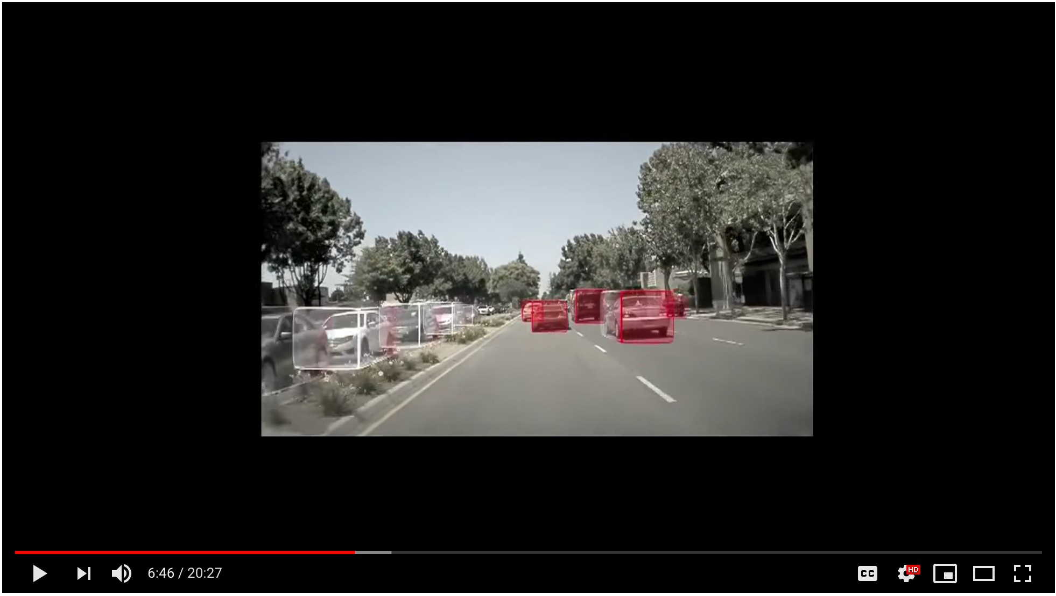
Self-driving cars
Source: https://youtu.be/URmxzxYlmtg?t=6m30s

Slide 4
Classification of methodologies
Supervised learning
Unsupervised learning
Reinforcement learning

Slide 5

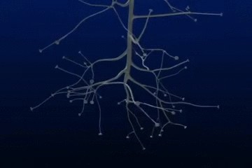
Conceptually, what are artificial neural networks?
A neuron receives a signal, processes it, and propagates the signal (or not)
The brain is comprised of around 100 billion neurons, each connected to ~10k other neurons: 10¹⁵ synaptic connections
ANNs are a simplistic imitation of a brain comprised of dense net of simple structures
Source: http://bit.ly/2jjGlNd

Slide 6
Conceptual mathematical model
•
•
Receives input from n sources Computes weighted sum
h₁ = x₁w₁ + x₂w₂ + . . . x_{n}w_{n}
Passes through an activation function Sends the signal to m succeeding neurons
w
o₁ o₂
. . . ³
o_{m}
1
w
2
w₃
∑
f(∑)
. . .
w_{n}
o
•
•

Slide 7
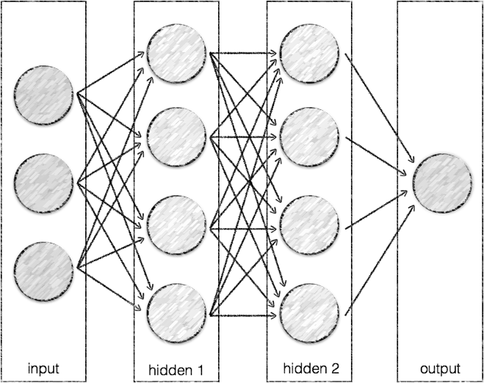
Artificial Neural Network
•
Organized into layers of neurons as a black- box model
Typically 3 or more: input, hidden and output For image detectors,
the first layers are organized similar as the visual cortex,
but activation functions are simpler for ANNs vs. biological neural networks
•
•
•
•

Slide 8
Perceptron
Simplified (binary) artificial neuron
Do I snowboard this weekend?
x₁ → Is the weather good? x₂ → Is the traffic good?
x₃ → Am I in the mood to drive?
𝑥₁
𝑥₂
?
output
𝑥₃

Slide 9
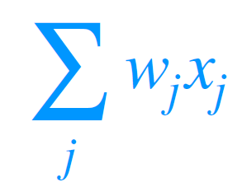
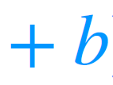
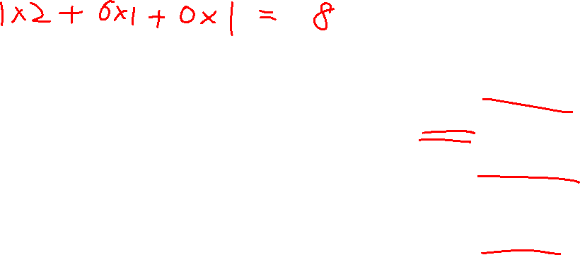
Perceptron
Simplified (binary) artificial neuron; add weights
Persona: Shredder
Do I snowboard this weekend?
𝑤 𝑥
1 1
Threshold=5
x = 1 (good weather)
1
w₁ = 2
x₂ = 1 (No traffic jam) w₂ = 6
x₃ = 0 (bad mood)
w₃ = 1
Output=1
𝑤₂𝑥₂
?
𝑤₃𝑥₃
= 2 + 6 + 0 = 8
j
Bias = 0

Slide 10
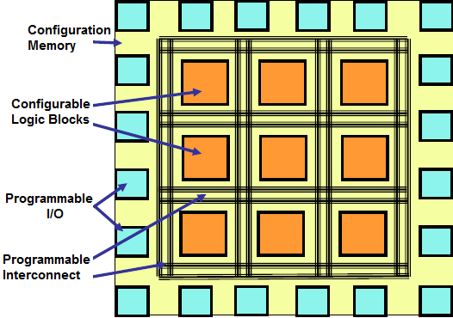
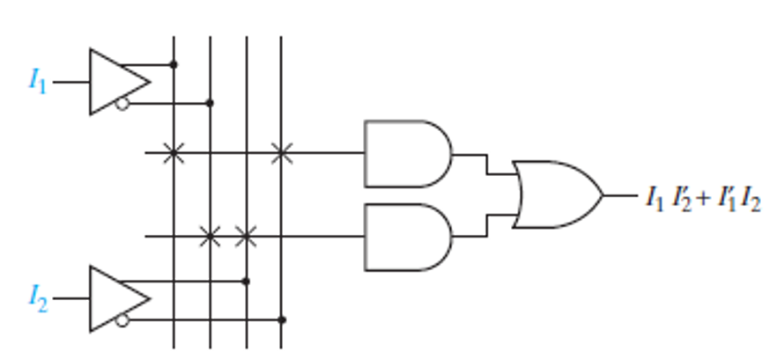
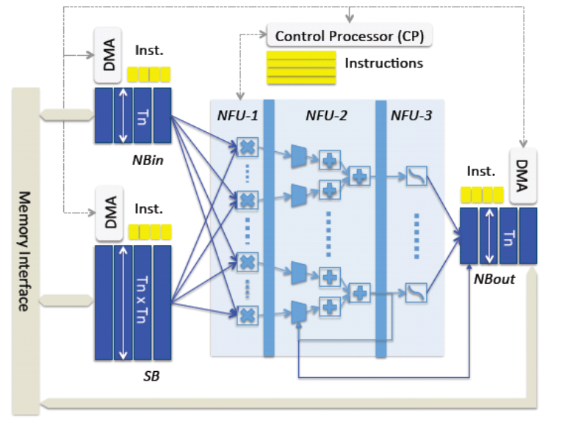
Why use it to design the circuit
FPGA
vs.
Neural Network

Slide 11
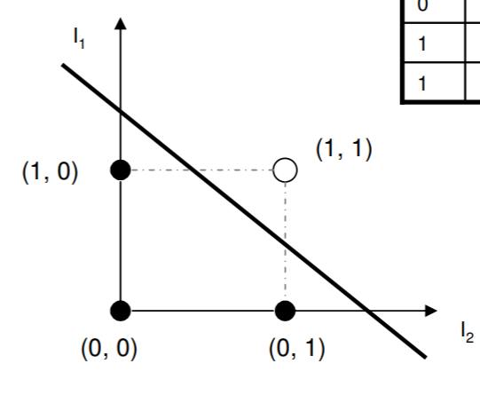
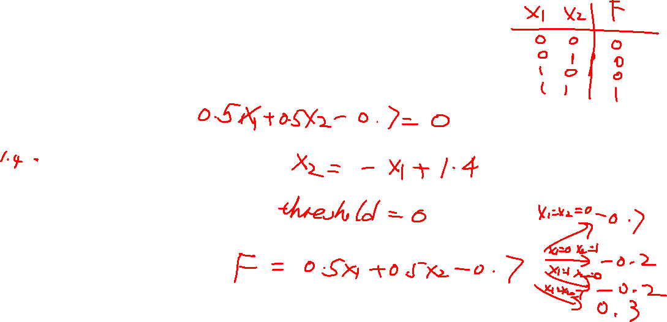
Lab content
Use simplified (binary) artificial neuron to implement AND OR NAND gate:
https://www.online-python.com/
Complete AND gate by configuring the parameters.
Complete OR and NAND gates. Checked me or submit the screenshot to canvas.
w2
w1

Slide 12
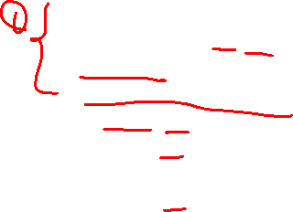
import numpy as np
def AND(x1,x2):
x = np.array([x1,x2])
w = np.array([0.5,0.5])
b= -0.7
tmp = np.sum(w*x) + b
if tmp <= 0:
return 0
else:
return 1
print(AND(0,0))
print(AND(0,1))
print(AND(1,0))
print(AND(1,1))
import numpy as np
def OR(x1,x2):
x = np.array([x1,x2])
w = np.array([0.5,0.5])
b=
tmp = np.sum(w*x) + b
if tmp 0:
return 0
else:
return 1
print(OR(0,0))
print(OR(0,1))
print(OR(1,0))
print(OR(1,1))
import numpy as np
def NAND(x1,x2):
x = np.array([x1,x2])
w = np.array([0.5,0.5])
b=
tmp = np.sum(w*x) + b
if tmp 0:
return 0
else:
return 1
print(NAND(0,0))
print(NAND(0,1))
print(NAND(1,0))
print(NAND(1,1))

